Slide 1
pmp exam Pmbok 7
OVERVIEW

Slide 2
purpose
Examinations.
Qualifications
Skill Enhancement
The Standard for Project Management PMI’s Standard for Project Management
PMBOK 7 is on its way.

Slide 3
CHANGES
People (42%) – about leadership of your project team
Process (50%) – about the technical aspects of project management
Business Environment (8%) – about the link with organizational strategy

Slide 4
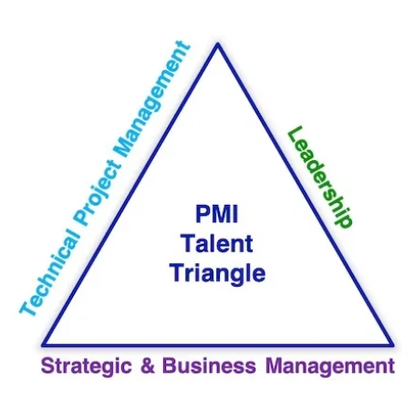
PMBOK 6

Slide 5
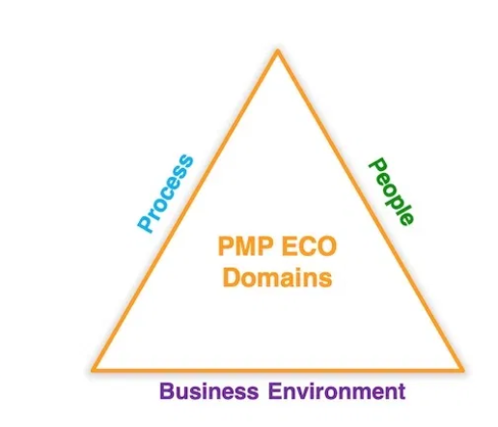
PMBOK 7

Slide 6
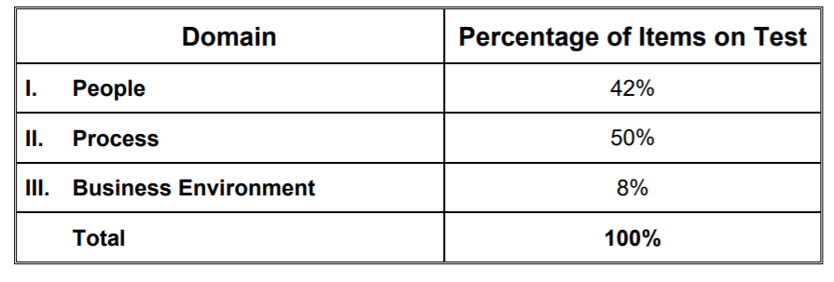
DOMAINS a High level knowledge areas

Slide 7
people
Manage Team
Lead Team
Support Team Performance
Empower Team Members and stakeholders
Ensure Team Members/stakeholders are adequately trained
Build a Team
Address and Remove impediments, obstacles and blockers from team.

Slide 8
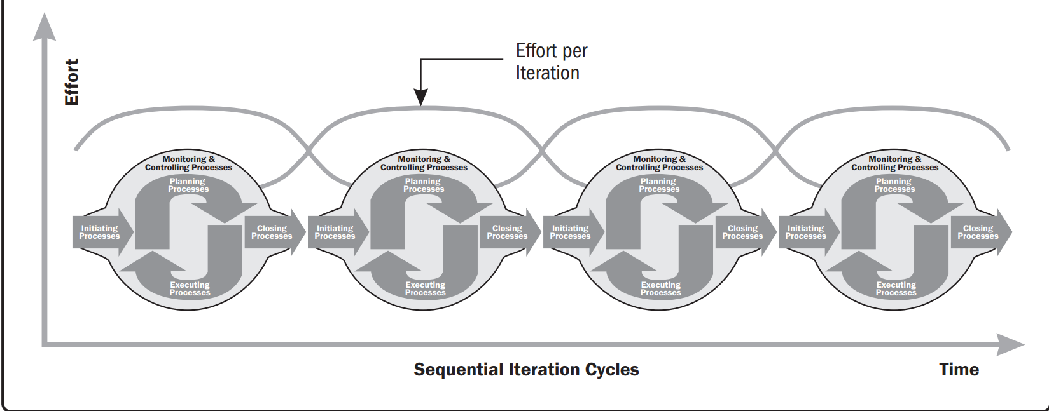

Slide 9
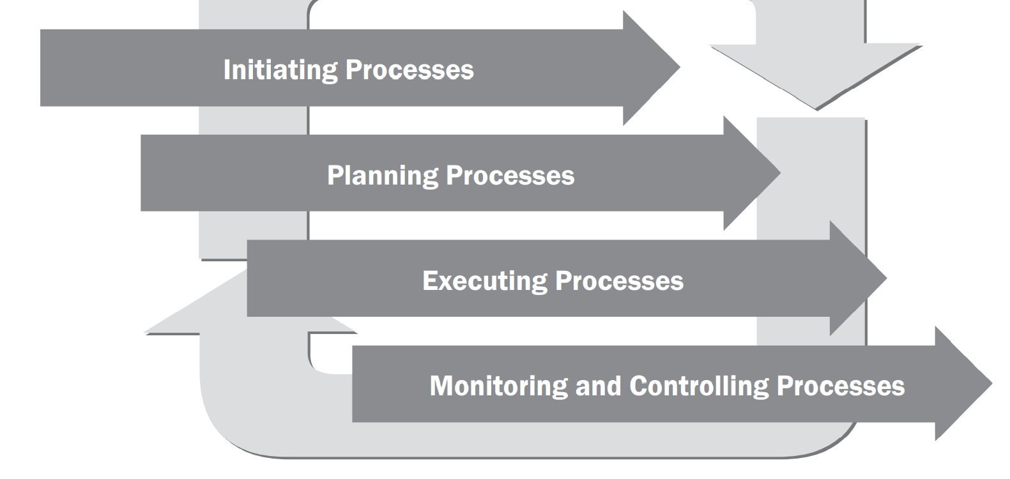

Slide 10
AGILE MANIFESTO

Slide 11
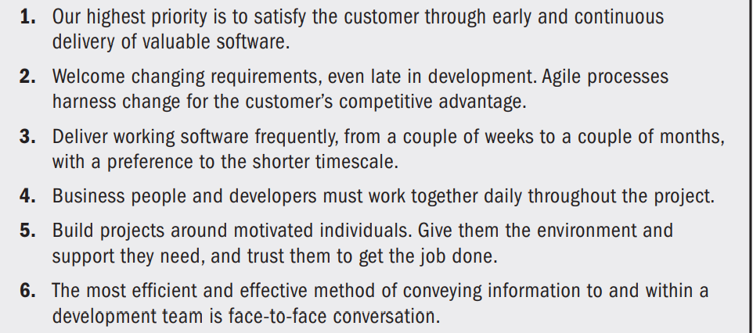
12 PRINCIPLES OF AGILE

Slide 12
12 PRINCIPLES

